Slide 1
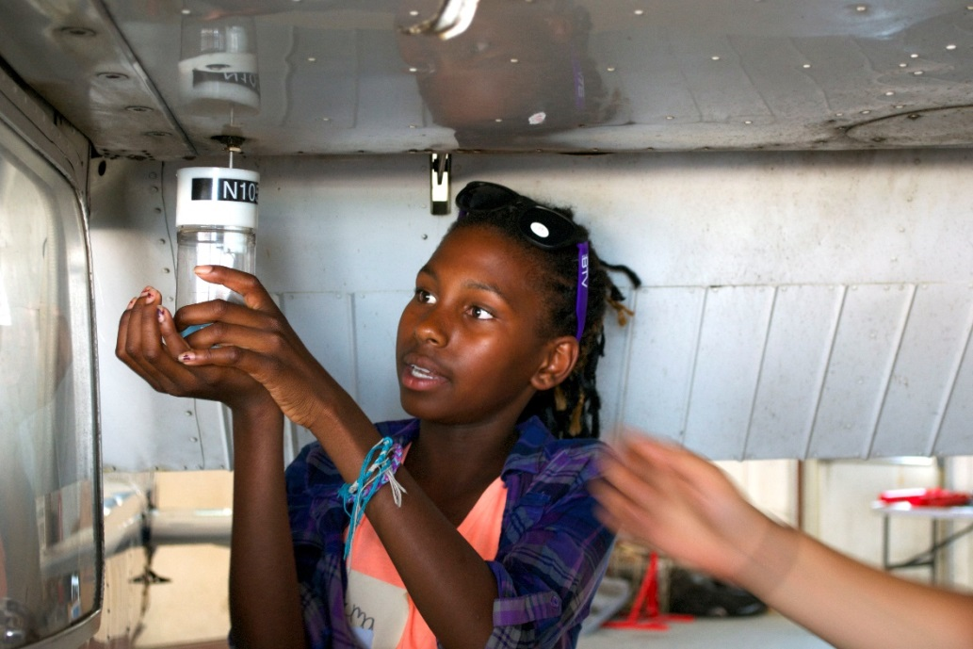
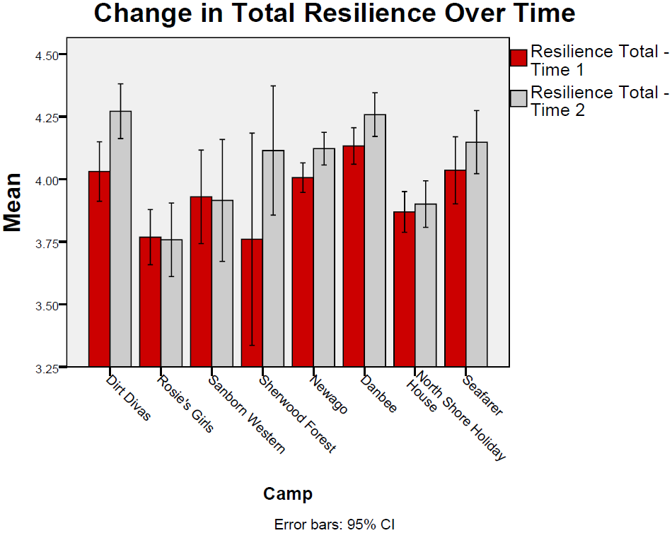
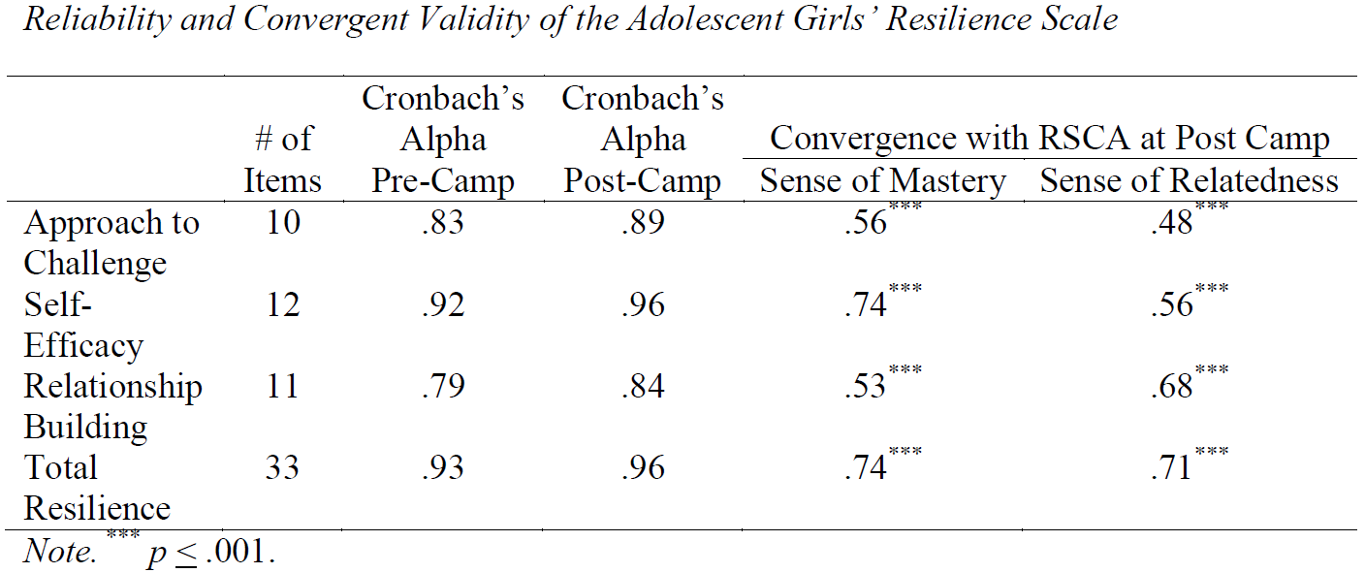
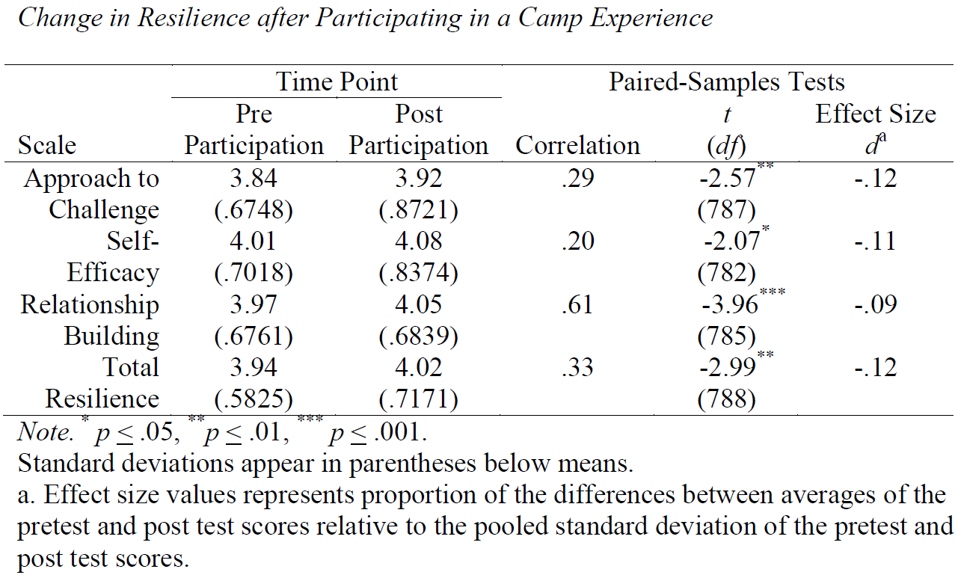
Measuring Outcomes of Girls’ Experiences
Anja Whittington & Jeffery Aspelmeier
Radford University
INTRODUCTION
Figure 1
Measuring how camp impacts girls’ lives can be challenging. Camp counselors and administrators know that camp can have a significant influence on a child's life. Through stories, quotes, journal writing and conversations we hear the many ways programs promote change. It has been suggested that camps develop ways to systematically collect data to accurately assess program outcomes. These measures (such as survey) should be valid and reliable and provide quantitative analysis of outcomes.
The purpose of the study was twofold:
1) to measure the outcomes of girls’ experiences at camp, and 2) to develop a valid and reliable instrument to measure these outcomes.
METHOD
Creation of a 34-item scale to measure girls’ resilience—Adolescent Girls’ Resilience Scale (AGRS).
Camps were approached to participate in the study. 8 different organizations participated in the study.
1072 girls completed the AGRS pre- and post-participation and 464 completed a comparison scale, Resiliency Scale for Children and Adolescents (RSCA)®, on the last day of their experience.
Table 1
RESULTS
The AGRS showed exceptional reliability across both time points.
The AGRS converged strongly with the RSCA. Approach to Challenge and Self-Efficacy converged strongly with sense of mastery and Relationship Building converged strongly with sense of relatedness.
Across all camps, small but significant, improvements were observed.
Evaluation of separate camps shows substantial increases in resilience after participating in some camps (i.e., Dirt Divas, Sherwood Forest), not in others.
IMPLICATIONS...
Table 2
Outcomes for Girls
The impact of camp experiences on girls’ resilience seems to vary across programs. Some programs have a large impact on resilience while other programs produce only modest change.
Differences in focus, scope, and delivery may account for the differential influence of camp experiences on girls resilience.
Adolescent Girls’ Resilience Scale (AGRS)
Is a valid and reliable instrument for measuring resilience change in girls.
Can be used in it’s entirety (34 items) or separated into three subscales (8-12 items/subscale): Approach to Challenge, Self-Efficacy and Relationship Building.
This scale measures those constructs of resilience that are most amenable to change—lacking is emotional reactivity and external supports.
2015 ACA Camp Research Symposium, New Orleans, LA

